Slide 1


Escribiendo código de alto rendimiento en .NET
2022
17/09/2022
Notes:
Jorge

Slide 2
Notes:
Jorge

Slide 3



Manuel Cañete
SRE / Platform engineer at Docplanner Tech
mknet3
@mknet_
Notes:
Manu

Slide 4


Jorge Turrado
SRE Expert at SCRM Lidl International Hub
Microsoft MVP
KEDA Maintainer
JorTurFer
@JorgeTurrado
Notes:
Jorge

Slide 5
Agenda
01
Garbage Collector
02
BenchmarkDotNet
03
ArrayPool<T>
04
Span<T>
05
Channels
06
Pipelines
Notes:
Jorge

Slide 6
Main concepts: Stack vs Heap
Stack | Heap
LIFO data structure with fixed size | Collection of memory segments unordered
Its access is fast | It is access is slow
It stores value types | It stores reference types
Each C# Thread has its own stack
Notes:
Manu

Slide 7
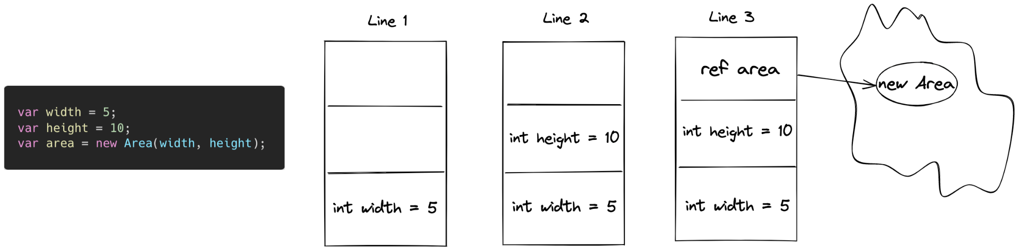
Main concepts: Stack vs Heap
Notes:
Manu

Slide 8
Main concepts: Boxing vs Unboxing
Boxing is the process of converting a value type to an object type and it is stored in the heap. This process is implicit.
Unboxing extracts the value type from the object.
Boxing / unboxing are expensive processes.
Notes:
Jorge

Slide 9
Garbage Collector
GC manages the allocation and release of memory for an application.
It will always work on the managed Heap.
The fewer objects allocated on the heap the less work the garbage collector has to do.
Notes:
Jorge

Slide 10
Generations
Generation 0: short-lived objects
Generation 1: short-lived objects
Generation 2: long-lived objects
Generation 3: Large Object Heap (LOH)
Objects >= 85,000 bytes
Logically collected as part of generation 2
Notes:
Manu

Slide 11
Generations
User code can only allocate in Gen0 or the LOH (large objects).
GC can allocate in Gen1 (from Gen0) and Gen2 (from Gen1).
Notes:
Manu

Slide 12
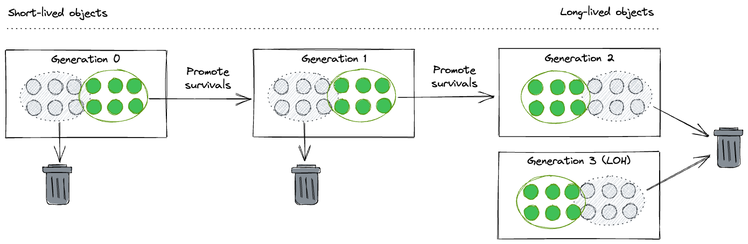
Generations
Notes:
Manu

Slide 13
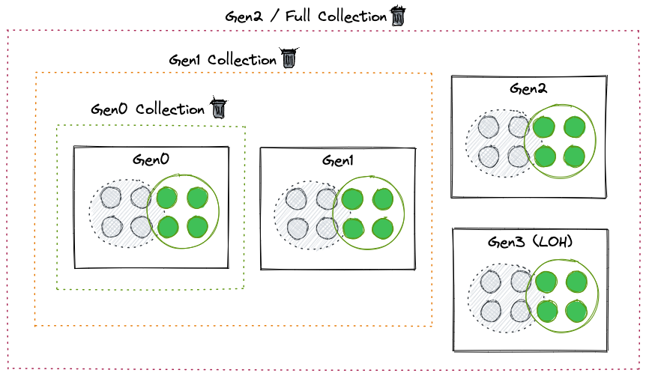
Garbage Collections
Notes:
Manu

Slide 14

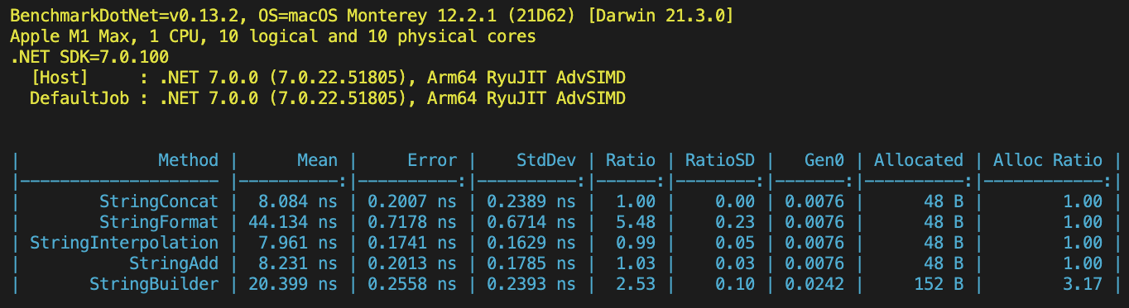
BenchmarkDotNet
.NET library to track performance and visualize results
Notes:
Jorge

Slide 15
High-performance logging
Logger extension methods (e.g. LogError) require boxing value types.
LoggerMessage pattern avoids boxing by using static Action fields and extension methods with strongly typed parameters.
Notes:
Jorge

Slide 16
ArrayPool<T>
High-performance pool of reusable managed arrays.
In an scenario with many arrays we can reuse the pool to avoid new allocations.
Notes:
Manu

Slide 17
Span<T>
Represents a contiguous region of arbitrary memory.
They can refer to data on the heap, on the stack using stackalloc and also unmanaged memory.
Notes:
Jorge

Slide 18
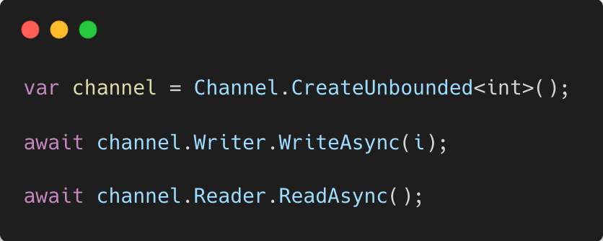
System.Threading.Channels
A channel is a data structure use to pass data between producers and consumers
Simple
Thread-safe
Asynchronous, no synchronously-blocking APIs
Notes:
Manu

Slide 19
System.IO.Pipelines
Make high performance IO code easier
Notes:
Jorge

Slide 20
Conclusiones
No sacrifiques legibilidad por rendimiento si no es estrictamente necesario
Medir, optimizar y medir
Notes:
Jorge

Slide 21
Q&A

Slide 23
More information:
info@netcoreconf.com
@Netcoreconf
Visit on:
netcoreconf.com
Thank's

